Slide 1





Monitoring of Participation and Results of (rural) Job and Opportunity Fairs
A Practical How-To-Guide
by the Global Project „Rural Youth Employment“

Slide 2






Table of Content: M&E of (rural) Job and Opportunity Fairs
What’s a (rural) opportunity and job fair?
What are targets and requirements?
What tools to use?
How to collect the data?
How to use the data?
CLICK ON A SECTION TO NAVIGATE

Slide 3





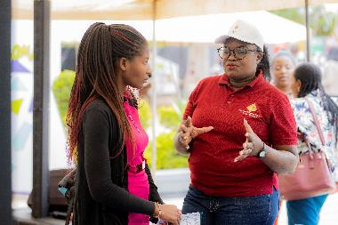

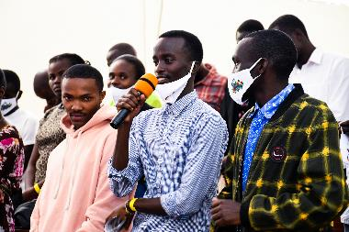
Experiences are based on rural job and opportunity fairs in Kenya, Malawi, Mozambique and Burkina Faso organized in 2022 and 2023.
What is a rural job fair?
Rural Job and Opportunity Fairs highlight available job and self-employment opportunities in the agri-food sector and other supporting activities such as agricultural courses, incubation programs, and improve the image of the sector.
They provide a platform to rural youth, enterprises, NGOs, public entities („exhibitors“) to exchange, network and match employment
Youth include students/alumni, job seekers and entrepreneurs.
Opportunities are provided by exhibitors. Examples from the agri-food sector are estates, processors, service providers, Gig-Economy-Apps, Youth Groups, ATVET institutes, Business Development Services, Extensionists etc.
Opportunities are finding employment, improve job seeking capacities including CV writing or job interview preparations, create networks for (self-)employment and identify support offers like trainings, incubation, acceleration, coaching etc.
The job fairs were physical events, with hybrid parts that were streamed in Kenya. Venues have been ATVET institutes and incubators.
Invitations of rural youth and exhibitors was either publicly advertised or restricted (invitation only).
The organisation of the fairs have partly been outsourced to event managers, including M&E tasks.
Further resources how to organize rural job fairs:
How-To-Guide for Organising Rural Opportunity Fairs
Short Video Documentary of the opportunity fairs
Enough background, now let’s get started to design the M&E of the fair.

Slide 4
The first step is to define the targets for M&E. What do you want to know?
What are targets and requirements?
1) Preparation
2) Participation
3) Evaluation
4) Results
Registration about the exhibitors, information about their offers and searches for better planning of the fair
Advertising to the youth
Total number of youth present at fair, with relevant disagreggations
Sociodemographic information to know the target group better
Total number of exhibitors present at fair
Information on their nature, sector and offer
Identify expectations, needs and experience of the participants (youth and exhibitors) and evaluate in how far these are met
Identify areas for improvement on the organisation (logistics, advertisement, venue) and the programme of the job fair.
Identify the improvement of the employment situation of jobseekers
Identify if job fair contributed to reach the objectives of the companies (e.g. filling vacancies, sell their services)
Identify if self-employed youth have established new contacts and networks, (e.g. input dealers, off-takers, clients)
In the next step, the information required to inform the targets needs to be defined in detail. Start with “Preparation”.

Slide 5
Participation measures the attendance at the fair, of both, youth and exhibitors.
What are targets and requirements?
2) Participation
Information on youth | Usage of information
Name | Head count of the total participation at fair while avoiding double counting
Gender and Age | Disaggregation of the total participation
County/District and Village | Identify the catchment area of the fair
Highest Education | Better define target group of the fair
Contact details, e.g. Phone Number, email | Contact the participants after the job fair to monitor the effectiveness
Information on exhibitors | Usage of information
Name and nature (e.g. company) | Count the total participation avoiding double counting
Company Contact Person (Focal Point) | To know who to turn to in case of questions
Contact details, e.g. Phone Number, email | Contact the company after the job fair to monitor the effectiveness
Province of reference | Identify the catchment area of the fair
Continue with “Evaluation”.

Slide 6
Then you need to define very specifically which information you need to collect to inform your targets. We start with preparation.
What are targets and requirements?
1) Preparation
Information on exhibitors | Usage of information
Name and nature (e.g. company) | Count the total participation avoiding double counting, plan the logistics and the programme
Company Contact Person (Focal Point) | To know who to turn to in case of questions
Contact details, e.g. Phone Number, email | Contact the company after the job fair to monitor the results
Province of reference | Identify the catchment area of the fair
Reasons to attend | Get the expectations of exhibitors to be able to make adjustment to better meet them.
Offers | e.g. job vacancies, search to buy produce, offer of products, services and input. Could be used for advertising to the youth, to enhance participants' preparation and avoid miscommunication and disappointment
Continue with “Participation”.

Slide 7
This is the information you need to collect to inform your targets on evaluating the job fair.
What are targets and requirements?
3) Evaluation
Jobseeker’s Evaluation | Concrete items for evaluation
Satisfaction with the job fair | Logistics, schedule, programme, information, selection of exhibitors, job vacancies offered, contact with exhibitors.
Did the fair meet the expectations and needs | Relevance and helpfulness of the job fair for finding a job, networking, finding support services.
Interaction between exhibitors and employers | Number of interactions with exhibitors, which kind of exhibitors, CVs submitted to employers, are the job offers interesting/suitable. If little or no fitting offers: what were the reasons given?
Participation in program (e.g. workshops, presentations) | Which program items did the youth participate in? Why, why not?
Exhibitors’ Evaluation | Concrete items for evaluation
Satisfaction with the job fair, reasons and expectations to attend | Why do they attend? Satisfaction with logistics, schedule, programme, information? Willingness to participate in future fairs? How much would the company pay for a booth?
Did the fair meet the expectations and needs | Relevance and helpfulness of the job fair for finding skilled workers, networking.
Interaction between exhibitors and employers | Number of interactions with job seekers; what were generally their strength and weaknesses with regard to their technical, business, soft skills.
Finish with “Results”.

Slide 8
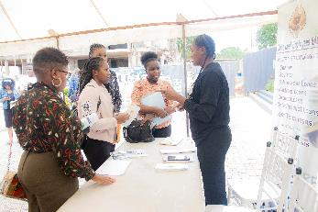
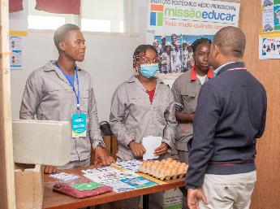
As results refers to the change over time in situation or habits, you will need to collect information in a baseline and in an endline.
What are targets and requirements?
4) Results
Jobseeker Baseline
What is their current employment situation? How do they gain income? How much? Why are they participating at the fair? What opportunities are they looking for? What is their work experience? What further qualifications do they have?
Jobseeker Endline
What is their current employment situation? How do they gain income? How much? What opportunities could they seize? How was the job fair useful for them (with regard to finding employment, getting further support e.g. coaching, training etc., creating networks…)?
Exhibitors Baseline
The information included under “Preparation” should suffice.
Exhibitors Endline
Companies: How many candidates have been invited to an interview? How many vacancies have been filled? How useful was the job fair to fill the vacancies? Which job profiles have not been filled? Other exhibitors: Market linkages created, produce sold etc.
Your next step is to design tools to collect these information with.

Slide 9
These are tools you can use to collect data before the job fair. It is not one tool per target or requirement, but targets need more than one tool
What tools to use?
Tool | Link to tools Double click on the icon top open | Covered targets and required information
Participant’s list |  | Participation: Total number of youth, sociodemographic information
Baseline Survey for youth |  | Results: Jobseeker Baseline
Registration Letter for exhibitors Alternatively: Participants List for exhibitors |  | Preparation: Exhibitors to be present Participation: Total number of exhibitors, Information on their nature, sector and offer
Vacancy listing for companies |  | Preparation: Exhibitors offers and search Results: Exhibitors Baseline
pt
fr
en
en
fr
pt
en
Check out the tools that you can use to collect data after the fair.

Slide 10
These are tools you can use to collect data after the job fair.
All tools need to be adapted to the actual fair.
What tools to use?
Tool | Link to tools Double click on the icon top open | Covered targets and required information
Evaluation form youth |  | Youth’s Evaluation
Evaluation form exhibitors |  | Exhibitor‘s Evaluation
Tracer survey for youth | Under development | Results: jobseeker Endline
Tracer survey for exhibitors Companies |  | Results: exhibitors endline
Tracer survey for exhibitors Buyers and Sellers |  | Results: exhibitors endline These have not yet been applied or tested, as the strategic outline of the job fairs have focussed on companies.
pt
en
en
pt
en
pt
en
en
en
en
Now you need to define how these tools are used.

Slide 11
This is how we used the tools to collect data before or at the beginning of the fair, you will need enumerators on the ground!
How to collect the data?
Tool | Data collection
Participant’s list | On the ground during the job fair having (a) registration desk(s) at the entry(s). Especially if there is no fix entry, it needs enumerators on the ground who register the participants. It can be helpful to open registration online beforehand to only verify the data on the ground. Participant’s list should only include 3-5 questions per participants.
Baseline Survey for youth | If it is very short (2-3 questions) it can be integrated into the participants lists. But in general it is advisable to have the enumerators on the ground draw a random sample of the youth and do the survey separated from the participant’s list. Verify which information you can also just include in the evaluation form for youth (see next slide), you can design one tool for multiple reasons of data collection.
Registration Letter for exhibitors | The registration letter should be send to and from the exhibitors before the fair. It is also their commitment/booking of a stand.
Vacancy listing for companies | The vacancy listing should be attached to the registration letter, but implementation showed that it is necessary to collect the vacancy listing on the spot anew.
Next slide shows how tools are used at the end and after the fair.

Slide 12
And this is how we applied the tools after or at the end of the fair.
Tracer surveys are done via phone calls afterwards.
How to collect the data?
Tool | Data collection
Evaluation form youth | A sample of youth at the job fair has been interviewed by enumerators on the ground using digital data collection tools on tablets (KoboToolbox).
Evaluation form exhibitors | The evaluation form has been printed and given to each exhibitor to fill it out at the end of the day. It was collected by enumerators before the end of the fair.
Tracer survey for youth | The tracer surveys are conducted as phone interviews 3-6 months after the job fair on a random sample drawn from the participant’s list.
Tracer survey for companies | Phone interviews after 4-6 months on all the registered companies. It was tested to do the interview at an earlier stage (1-2 months after the job fair), but companies reported that recruitment was not yet finished. To define when to do the tracing, perhaps the exhibitors can already include a tentative timeframe it may take them to finalize the recruitment process.
So that is how we did it, and on the next slide you find some DOs and DONTs for data collection.

Slide 13
Don’t make the same mistakes as we did.
How to collect the data?
DOs and DON’Ts
Include M&E since the beginning of the planning for a fair.
Do not only rely on online registration beforehand. It needs registration and interviews of exhibitors and youth on the ground.
Don’t trust that companies will send back the registration letter and vacancy list automatically in advance.
Beware of survey fatigue when registering youth. Rather keep it very short (max. five questions/columns on a participant’s list) and collect further (baseline) information only on a random sample.
Outsource all or nothing: If you are very clear on your objectives and tools for monitoring, do the data collection and analysis also yourself – as the service provider o will need a lot of on boarding and guidance.
Be on the ground yourself to organize and supervise the data collection.
Use digital data collection applications on tablets or smartphones on the ground to avoid laborious data entry tasks in the aftermath.
Pretest the final tools and technology used – if it doesn’t work on the day you are screwed.
Prepare well your enumerators. The tools need to be clear to them, their tasks as well! You may also prepare t-shirts and badges for the enumerators to be taken seriously and trusted on the ground:
And now you got alle the information and your targets are well informed. How to use it?

Slide 14
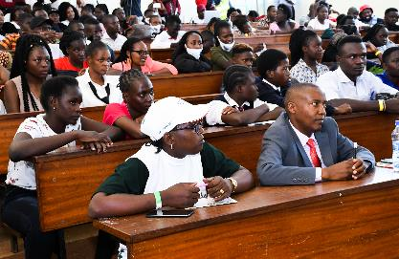
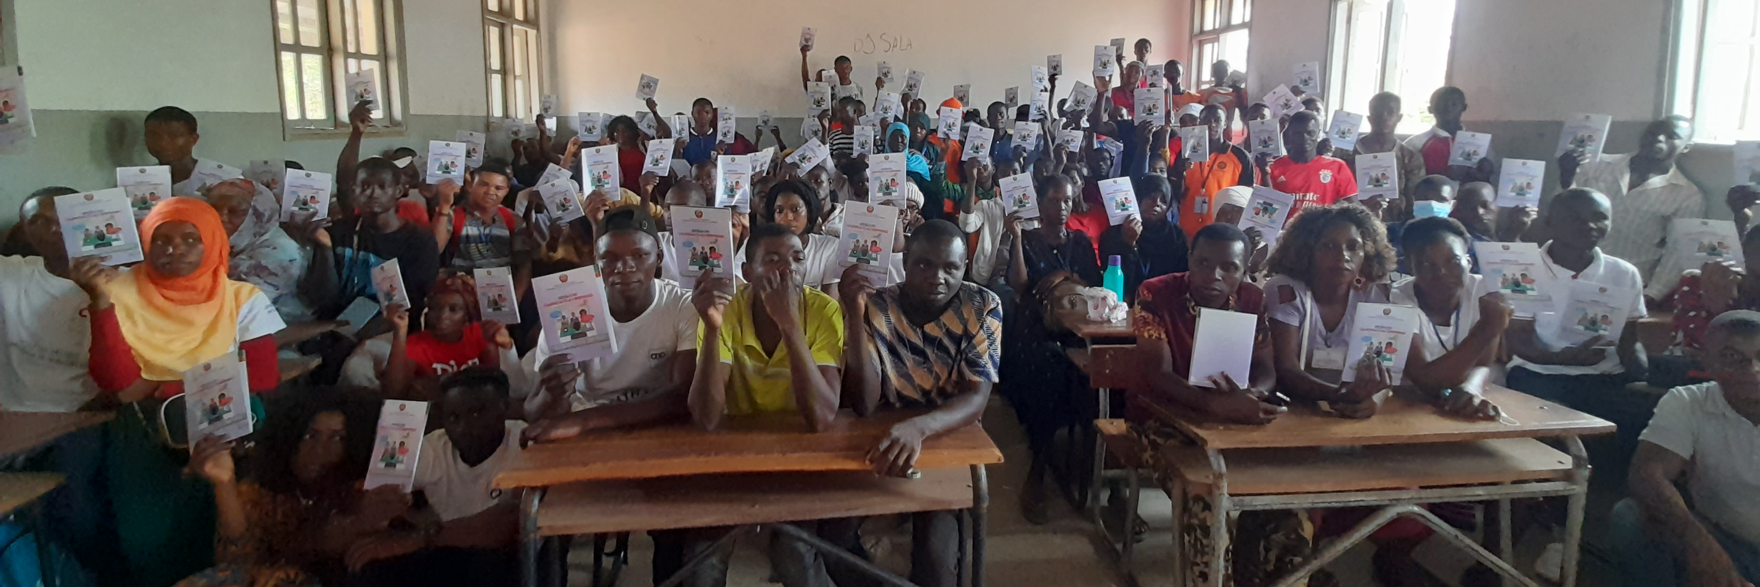
Do not forget the most important step: Use the insights to improve the next job fair!
How to use the data?
DOs and DON’Ts
And at the end:
Discuss the results with the team and the partners to clearly define the lessons learnt and what needs to be done better and differently.
Check ideas for formats of such discussions in this file:
Set up a cleaned participants data base. There will be a lot of double registrations if there are multiple people registering the participants. Cleaning will need some time.
Set up a dashboard or a presentation with the most relevant findings. A long written report is often not handy. Don’t be fooled: setting up a presentation that is to the point takes at least the time as writing a report.
Examples:
Use information for advertising the fair
If the registration of exhibitors is done timely beforehand, you can use information on exhibitors (how many companies, support structures, agro-dealers etc.) and their offers (how many vacancies, which commodities are in request, what inputs, goods and services are in offer) to advertise for the fair.
The results of the fairs:

Slide 15
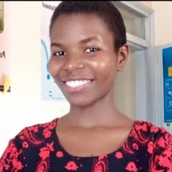





Any questions? Feel free to contact us!
Ruth Dorine Awino
Regina Gunda
Lukas Marx
Junior M&E-Advisor, Kisumu
M&E-Advisor, Lilongwe
Advisor, Bonn
ruth.awino@giz.de
LinkedIn
regina.gunda@giz.de
LinkedIn
lukas.marx@giz.de
LinkedIn
Gregory Kirimi Muriuki
Flavienne Ouandaogo
Armando Tsêlo
M&E-Advisor, Kisumu
M&E-Advisor, Ouagadougou
M&E-Advisor, Maputo
gregory.muriuki@giz.de
LinkedIn
flavienne.ouandaogo@giz.de
LinkedIn
armando.tselo@giz.de
LinkedIn

